Slide 1
Portable Ladder Safety
Presented by: Steve Caldwell
WHS Advisor (NTA)
Revision date: 22 April 2016

Slide 2
Introduction
Recently many unsafe practices seen.
Statistically every unsafe event is a precursor to a major accident.
Enthusiasm to do work quickly & efficiently is encouraged.
However, not at the expense of personal safety.
Make no mistake working from a ladder is a hazardous task.
Complacency is the biggest risk.

Slide 3
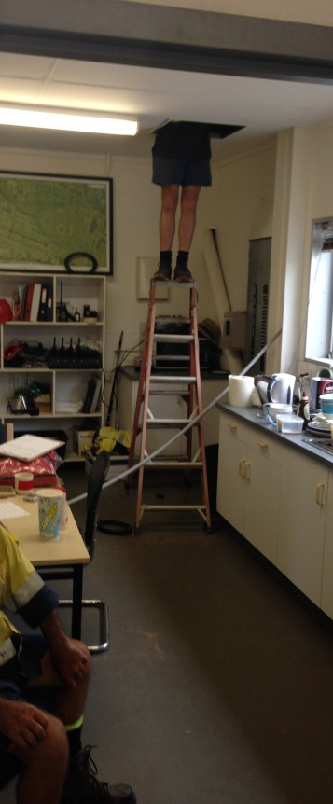
Presentation outline
Why ladder safety is important?
Ladder Accident statistics.
3) What makes ladders unsafe?
4) What’s been happening around us?
How can we make it safer?
So what can I do?

Slide 4
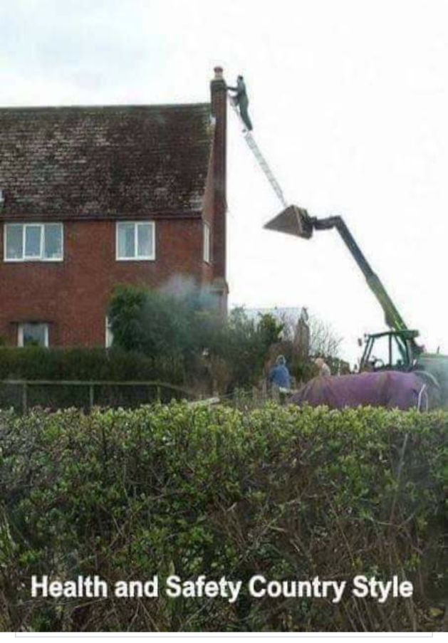
1) Why is ladder safety important?

Slide 5
1) Why is ladder safety important?
Ladders - commonly used in the workplace.
Most people - not trained in ladder safety.
Everyone is only one step away from a ladder accident.
If its not you, it may be a contractor you are responsible for.
Ladder accidents are more common than you think.
Let’s look at a ladder safety statistics prepared by Safe Work Australia.
Remember these are only the ones that are reported.

Slide 6
2) Ladder accident statistics
Safe Work Australia conducted study of injuries resulting from falls from height.
2003 – 2011
37 people died from falling off a ladder
2 of these deaths was from less than 1 metre
2009 – 2011
3,830 serious claims with time off work >1 week.
3 serious injuries every day.

Slide 7
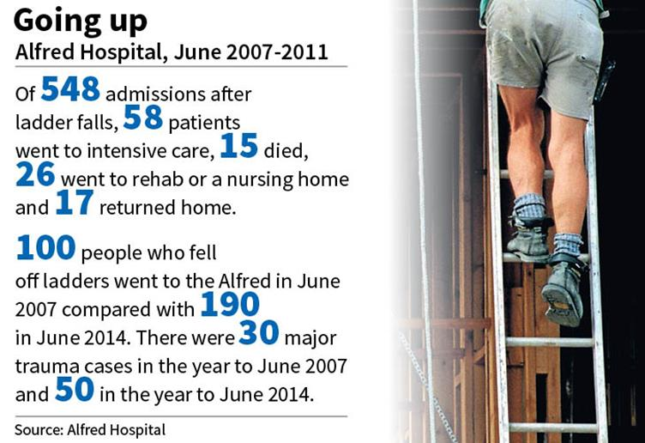
2) Ladder accident statistics

Slide 8
3) What makes ladders unsafe?
Working at height – risk of fall
Uneven ground & potential instability of ladder
Using wrong ladder for the task
Nothing to grip onto
Too small
Over-reaching
Task may require pulling or pushing
Unattended ladders in public areas – no solid barriers
Ladder collapse or slip
Anyone can use one – no licence or training often

Slide 9
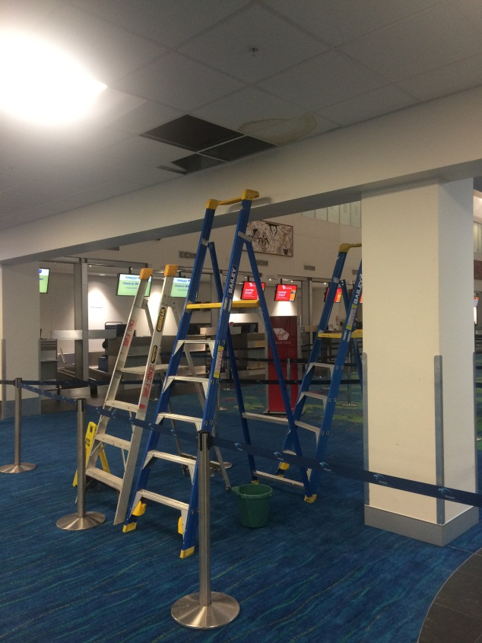
4) What’s happening around us?

Slide 10
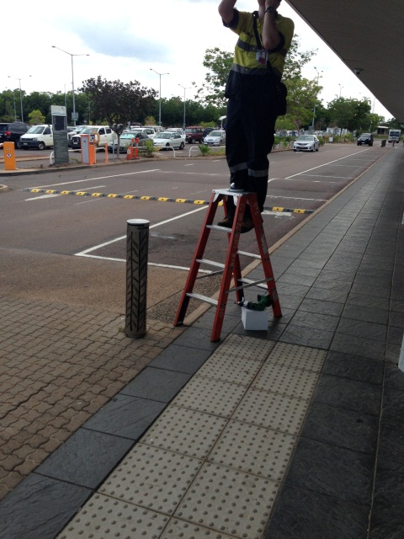
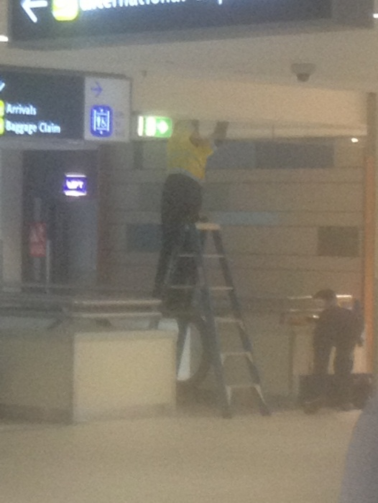
4) What’s happening around us?

Slide 11
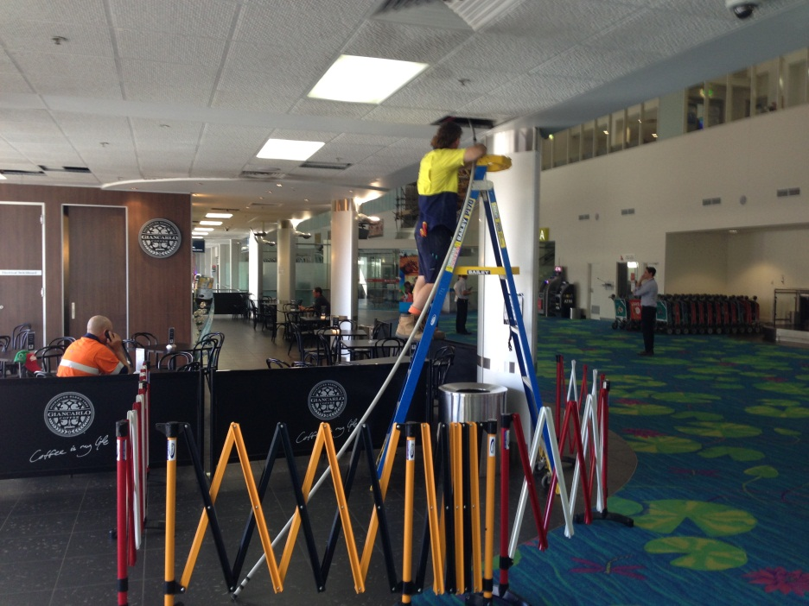
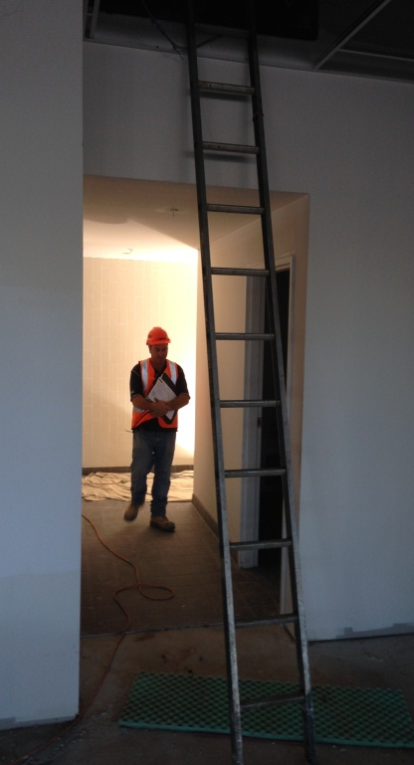
4) What’s happening around us?

Slide 12
5) How can we make it safer?
Whether you are a ladder user or responsible for people who use ladders you need to:
Plan ahead and
Identify need to use ladder - is it most appropriate method?
Conduct a risk assessment – based on task to be done and conditions
Select a ladder suitable for the task – use check list
Set up ladder safely – orientation, surface, support
Use ladder safely

Slide 13
5) How can we make it safer?
Risk assessment checklist can be used to determine if ladder is adequate for task.
Always use solid barriers in public areas
No. | Description | Yes | No
1 | Three points of contact at all times during access & egress | ◻ | ◻
2 | Is ground level & suitable for ladder use? | ◻ | ◻
3 | Never climb higher than the third rung from the top of the ladder. | ◻ | ◻
4 | Limit the climb to allow for a secure hold while working from ladder; ie worker can grasp ladder near waist height. | ◻ | ◻
5 | Task allows body to work between stiles | ◻ | ◻
6 | Ladder to be placed that permits the worker to face towards the ladder | ◻ | ◻
7 | Task can be done without leaning over the side of ladder. | ◻ | ◻
8 | Task does not require excessive pulling or pushing | ◻ | ◻
9 | Ladder rating & type suitable for task eg; electrical work | ◻ | ◻

Slide 14
5) How can we make it safer?
When conducting a risk assessment what should we consider:

Slide 15
5) How can we make it safer?
When conducting a risk assessment what should we consider:
Go through Risk Assessment (ladder selection) first.
What are the hazards? (remember a hazard is something with the potential to cause harm).
Falling from height
Ladder slipping
Member of the public
Operational escalator

Slide 16
5) How can we make it safer?
What are the controls to mitigate these risks?
Falling from height –
Is ladder best tool for the job in this location?
Ladder height? Waist height, facing right direction, reaching over side – OK?
Fall back or side ways – fall distance increased considerably
How do we mitigate this?
Could scissorlift have fitted here?

Slide 17
5) How can we make it safer?
What are the controls to mitigate these risks?
Ladder slipping – a real risk as the floor surface is metal.
How could we simply mitigate this risk?
Foot the ladder when being used.

Slide 18
5) How can we make it safer?
What are the controls to mitigate these risks?
Member of the public – an inquisitive child
Spotter looking other way
Disadvantages of spotter – don’t touch my child
Solid barriers – public space no exceptions

Slide 19
5) How can we make it safer?
What are the controls to mitigate these risks?
Operational escalator –
turn off escalator
barriers top and bottom
spotter top and bottom

Slide 20
6) What can I do?
Always conduct a risk assessment.
Working above 2 metres is a high risk construction activity & needs a Safe Work Method Statement to be completed.
If it is a simple ladder access job completing the Risk Assessment (ladder selection) may be all you need.
Ensure you, staff or contractors are following these simple guidelines.
Stop work if incorrect ladder is being used.
Ensure staff or contractors plan ahead and get the correct ladder for the job & barriers before they start the work.

Slide 21
Be proactive - Don’t be a statistic! Use ladders safely Thank You Any questions?

